Slide 1
COSP230 Ch. 10
Animation

Slide 2
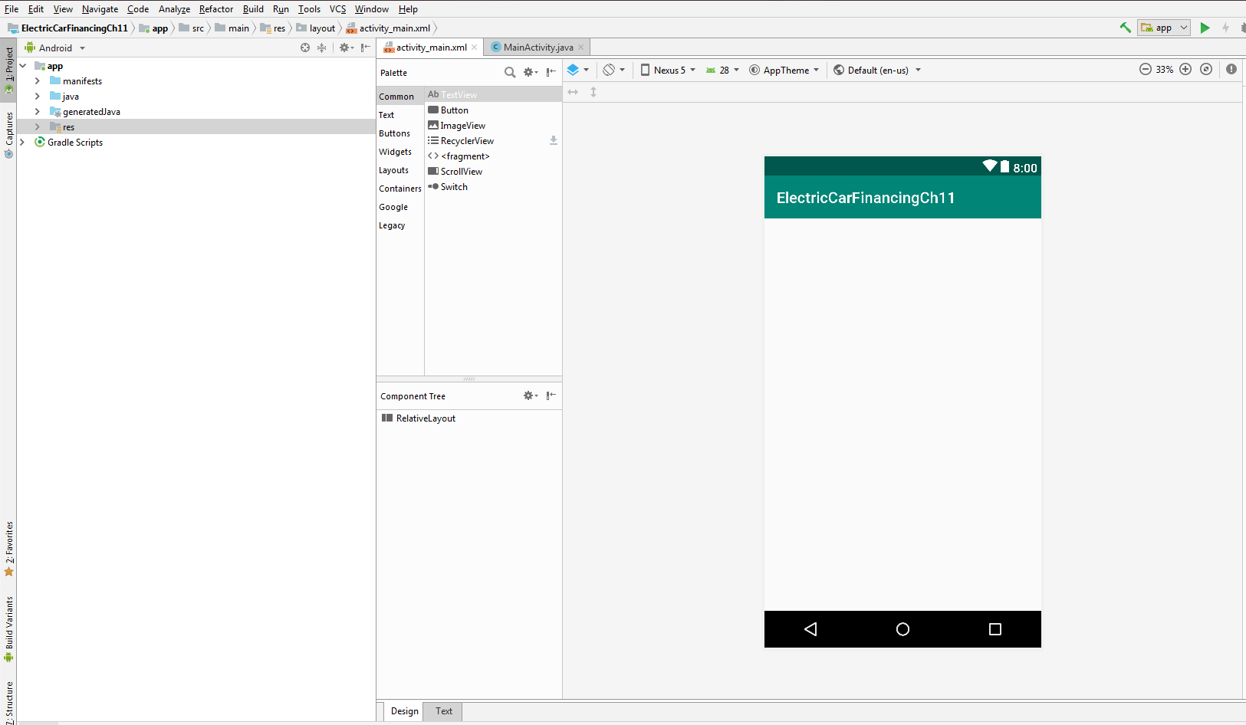
Start of Project (Delete HelloWorld text, select Nexus 5, change to Relative Layout):

Slide 3
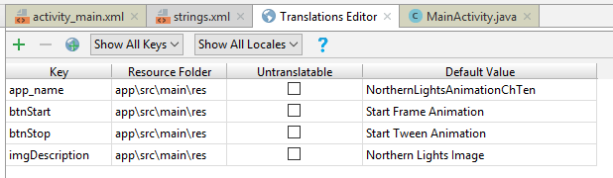
Add keys in Translations Editor
Open the Translations Editor
Add the keys in the table on the right:

Slide 4
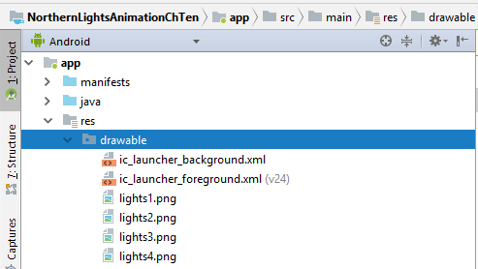
Add graphic files to drawable folder
Download the image files from the Ch Ten Images folder (Northern Lights subfolder)
Copy and paste the lights*.png files into the drawable folder

Slide 5
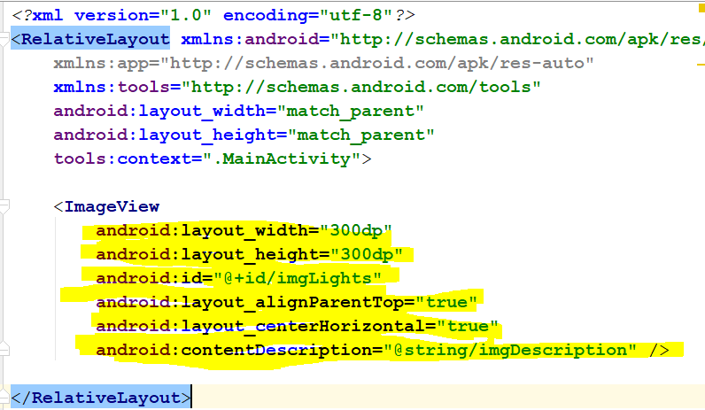
Update activity_main.xml for ImageView
Click the Text tab for activity_main.xml
Add the highlighted code

Slide 6
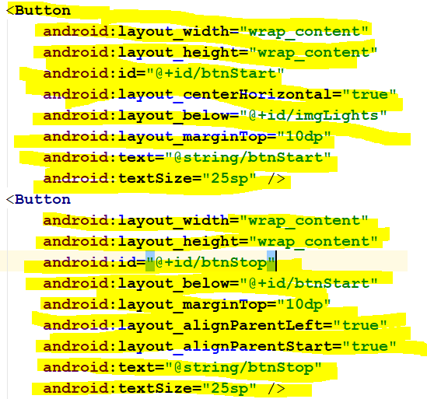
Update activity_main.xml to add Buttons
Add the highlighted code

Slide 7
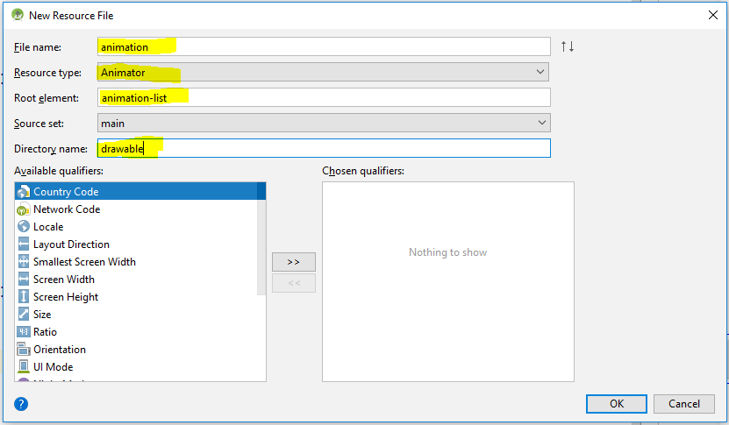
Add animation.xml file
Right click on res folder and then click the following:
New->Android resource file
Enter the highlighted values in their respective boxes

Slide 8
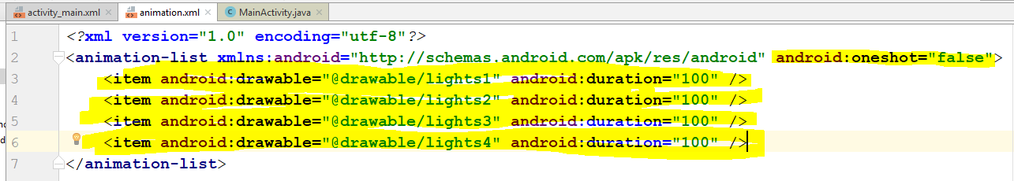
Update animation.xml to add animiation list
Add the highlighted code
oneshot= false creates a continuous loop of animation
duration=“100” means image will be displayed for 100 milliseconds

Slide 9
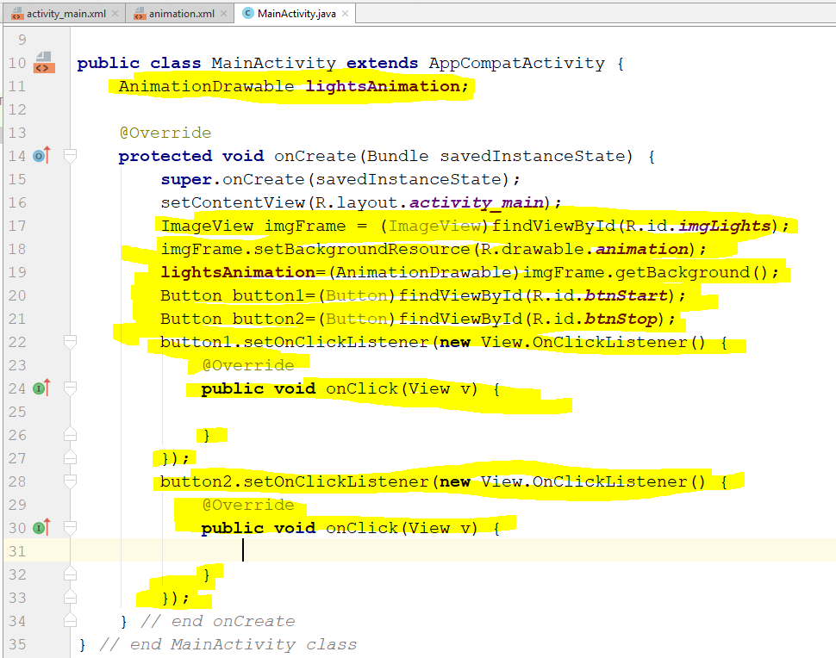
Update java code in MainActivity.java
Add highlighted code
Code in setOnClickView will auto populate
AnimationDrawable class provides methods for drawable animations to create a sequence of frame-by-frame images.
setBackgroundResource places images in a frame-by-frame slide type display.

Slide 10
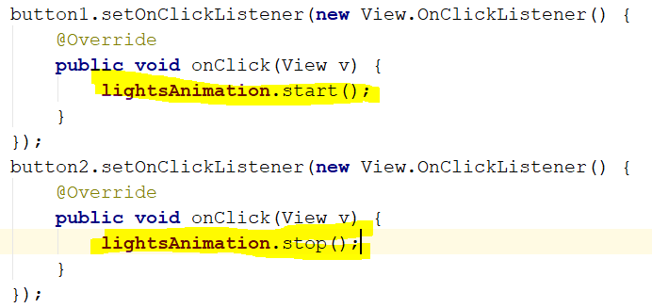
Add start() and stop() methods
start() – launces lightsAnimation.xml displaying animation-list items
stop() – ends display of animation-list so tween animation can begin

Slide 11
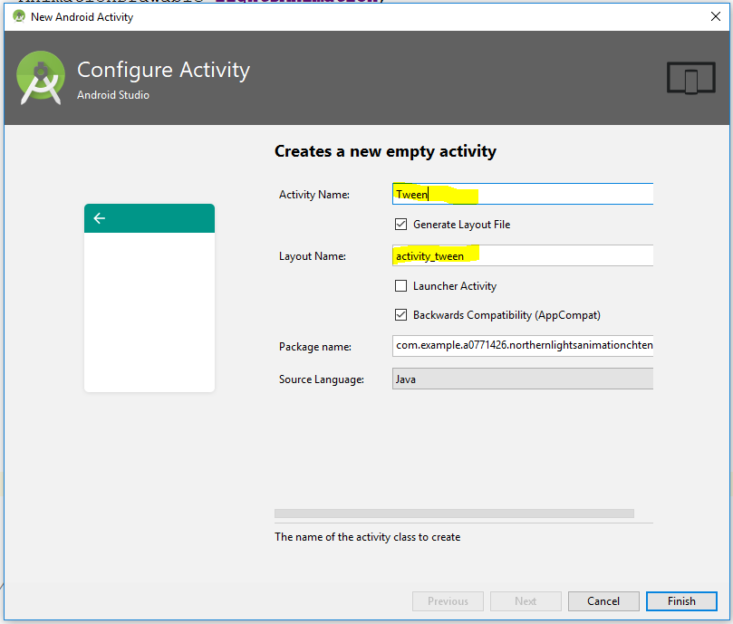
Create Tween Activity
In menu bar, click the following
File->New->Activity->Empty Activity
In the Configure Activity window, enter Tween for the Activity Name
Layout name will update automatically

Slide 12
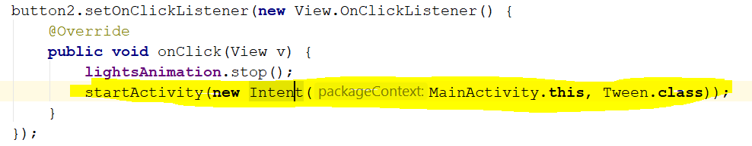
Add code to display Tween Activity
Call startActivity method with an Intent as shown

Slide 13
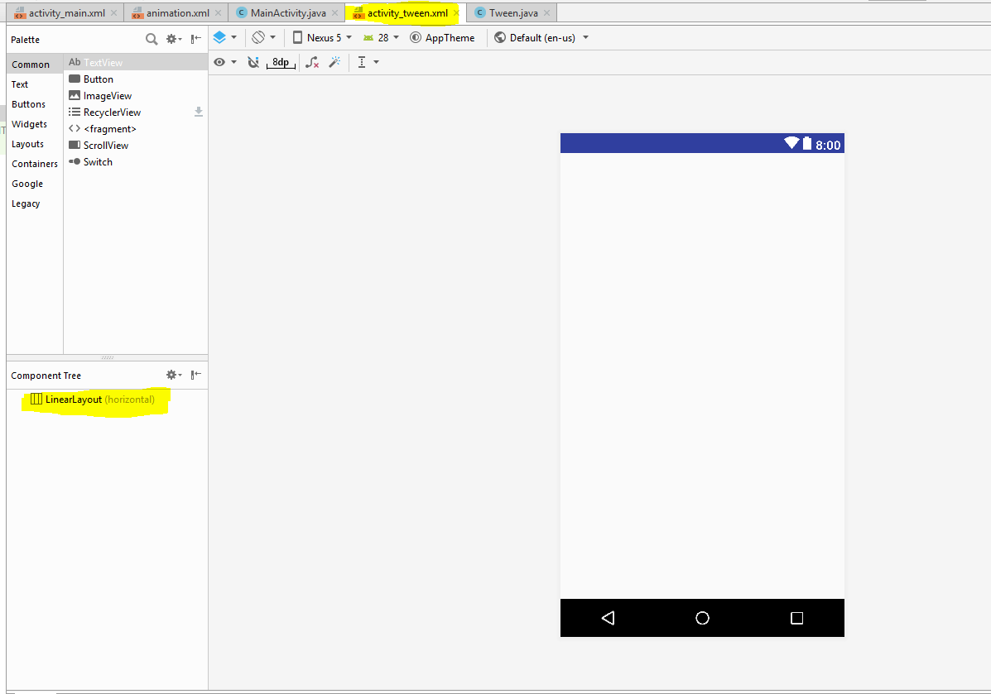
Convert activity_tween.xml to Linear Layout

Slide 14
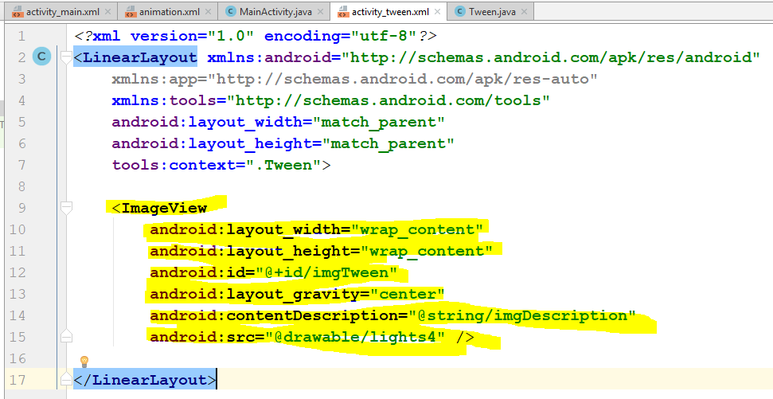
Update activity_tween.xml for ImageView
Click the Text tab for activity_tween.xml
Add the highlighted code

Slide 15
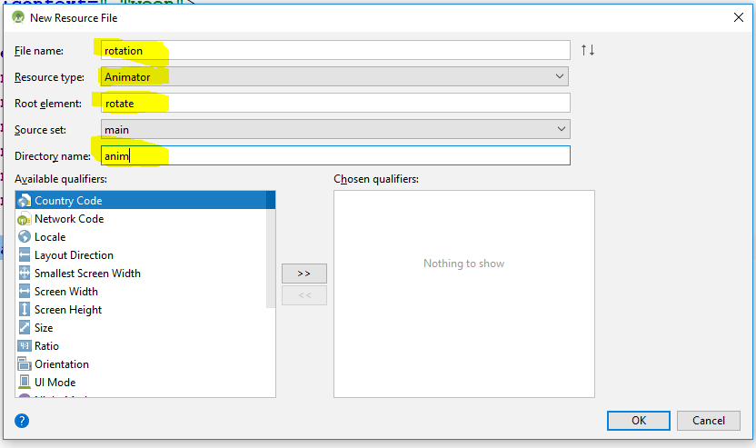
Add rotation.xml file
Right click on res folder and then click the following:
New->Android resource file
Enter the highlighted values in their respective boxes

Slide 16
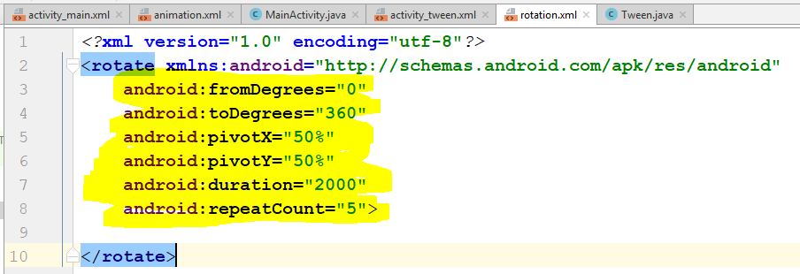
Add code within <rotate> tag in rotation.xml
Add highlighted code within the <rotate> tag
Code does not go between <rotate> and </rotate> tags

Slide 17
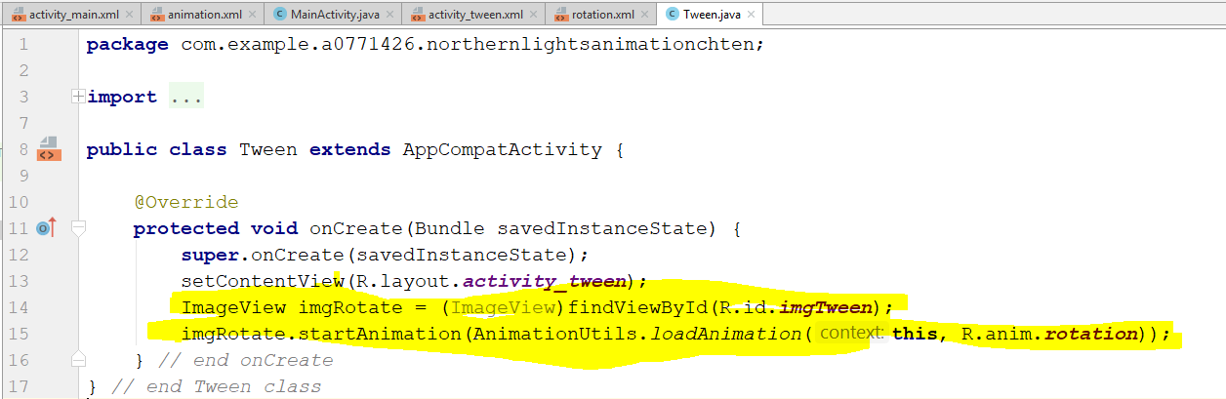
Update Tween.java
Create ImageView object
Call startAnimation method.

Slide 18
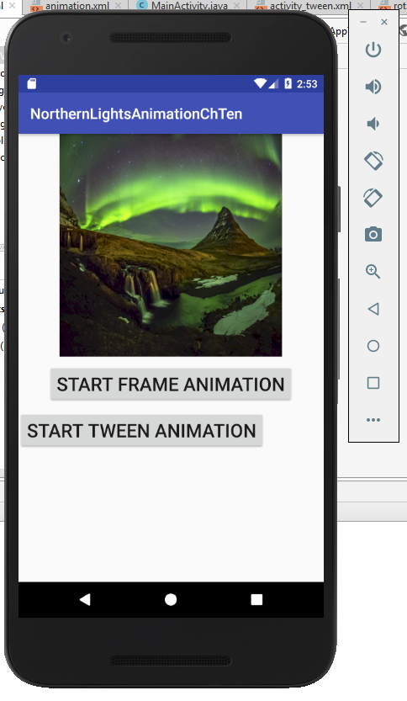
Run the app. You should get this:

Slide 19
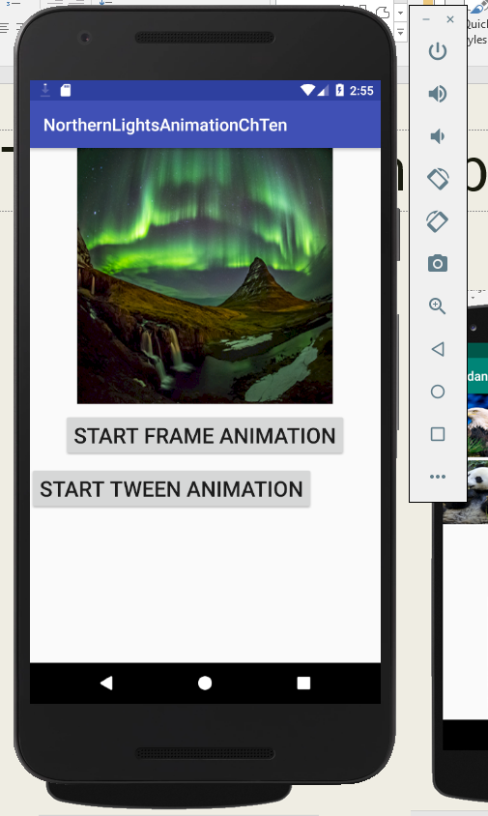
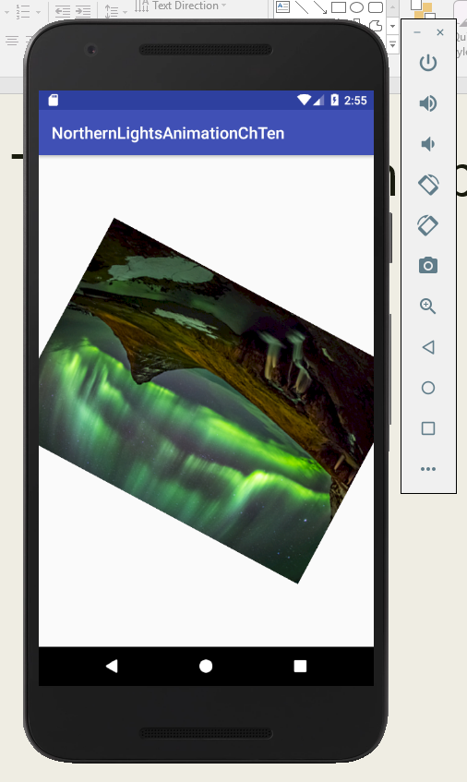
The two buttons produce these:

